Slide 1
Virtual Clothing Try-On
TS- WEB/CC/AI TRACK CAPSTONE PROJECT
Presented By:
1. Punna Srija - Avanthi Institute of Engineering & Technology-Hyderabad
2.
3.
4.
Guided By: Uma Maheswari

Slide 2
OUTLINE
Abstract
Problem Statement (Should not include solution)
Aims , Objective & Proposed System/Solution
System Design
System Development Approach(Technology Used)
Algorithm & Deployment
Conclusion
References
Future Scope

Slide 3
Abstract
Online shopping has become increasingly popular in recent years, and it's no surprise why. It's convenient, easy, and offers a wide range of products from the comfort of your own home. However, there's one issue that remains - how can online shoppers be sure that what they're purchasing will fit them correctly and look good on them? Enter virtual clothing try-on, an HTML-based application that allows users to upload an image of themselves and try on different outfits virtually.
The benefits of virtual clothing try-on are many. For one, it eliminates the need to physically go to a store and try on clothes. This is particularly beneficial for those who live in rural areas or have mobility issues. Additionally, it saves time and money by reducing the number of returns due to sizing or style issues. By seeing how the clothes look on them before making a purchase, users are less likely to buy something that doesn't fit or doesn't suit their style.
Implementing virtual clothing try-on is relatively simple. An HTML-based application can be created that allows users to upload an image of themselves and then superimpose clothing items over the image. The application could be integrated into an existing e-commerce website or offered as a standalone tool. The technology required for this is already available, and it's only a matter of time before it becomes a standard feature on many e-commerce websites.

Slide 4
Problem Statement
Online Shopping missing sizes.
Colour Variance.
Fitting problems.

Slide 5
Proposed Solution
Check the exact size with user.
It shows exact colour.
Shows perfectly fit’s or not

Slide 6
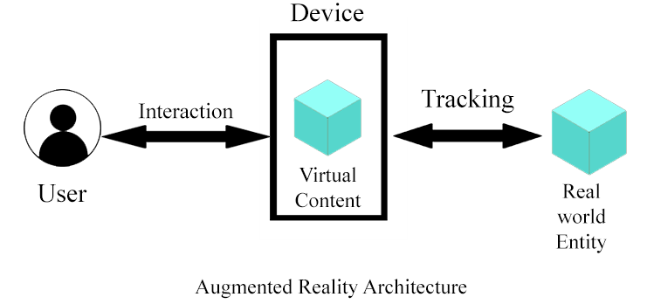
System Architecture

Slide 7
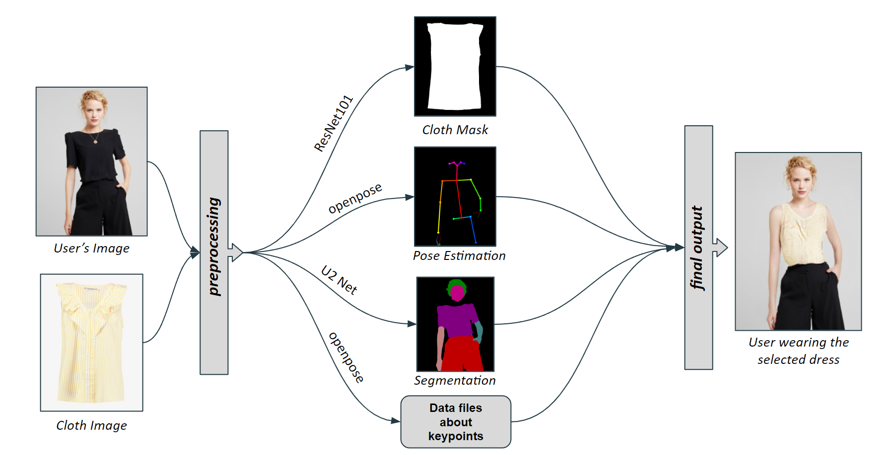
System Deployment Approach

Slide 8
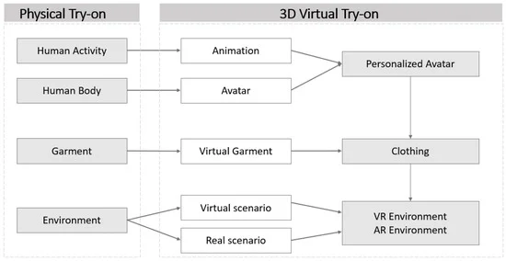
Algorithm & Deployment

Slide 9
THANK YOU

